Slide 1




The practicalities of using the RStudio Server for teaching R
Tom Beesley
wp.lancs.ac.uk/tombeesley
@BeesleyLAB
github.com/tombeesley

Slide 2
R at Lancaster
R now the only stats software we teach
PG has taught using R since 2013
UG since 2020 (previously SPSS)
Significant focus on data handling, visualisation, and “understanding data”; tidyverse
Inferential stats as one (final) part of the analysis pipeline

Slide 3
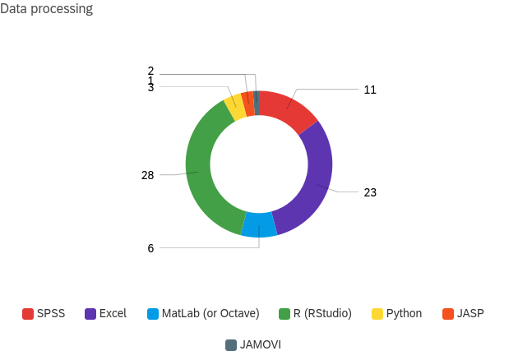
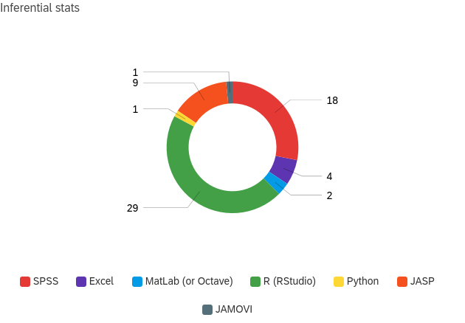
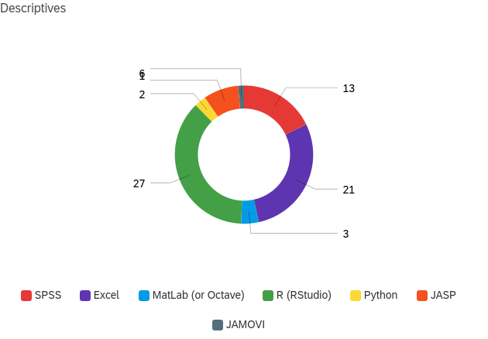
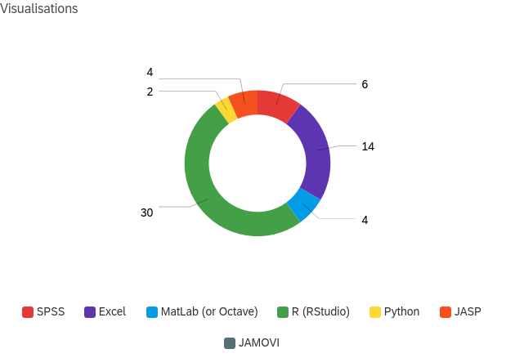
R use in the department (n = 35)
Data processing
Inferential stats
SPSS
SPSS
R
Excel
Excel
R
Descriptive stats
Visualisations
SPSS
SPSS
Excel
R
Excel
R

Slide 4
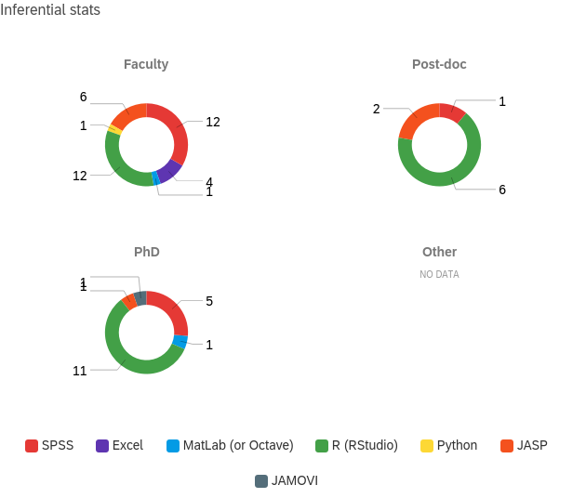
R use in the department (n = 35)
SPSS
SPSS
R
R
Junior research staff are driving us forward…
SPSS
R

Slide 5
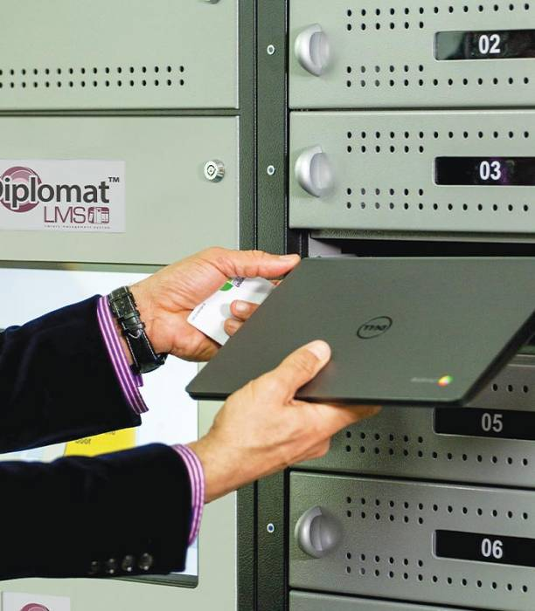
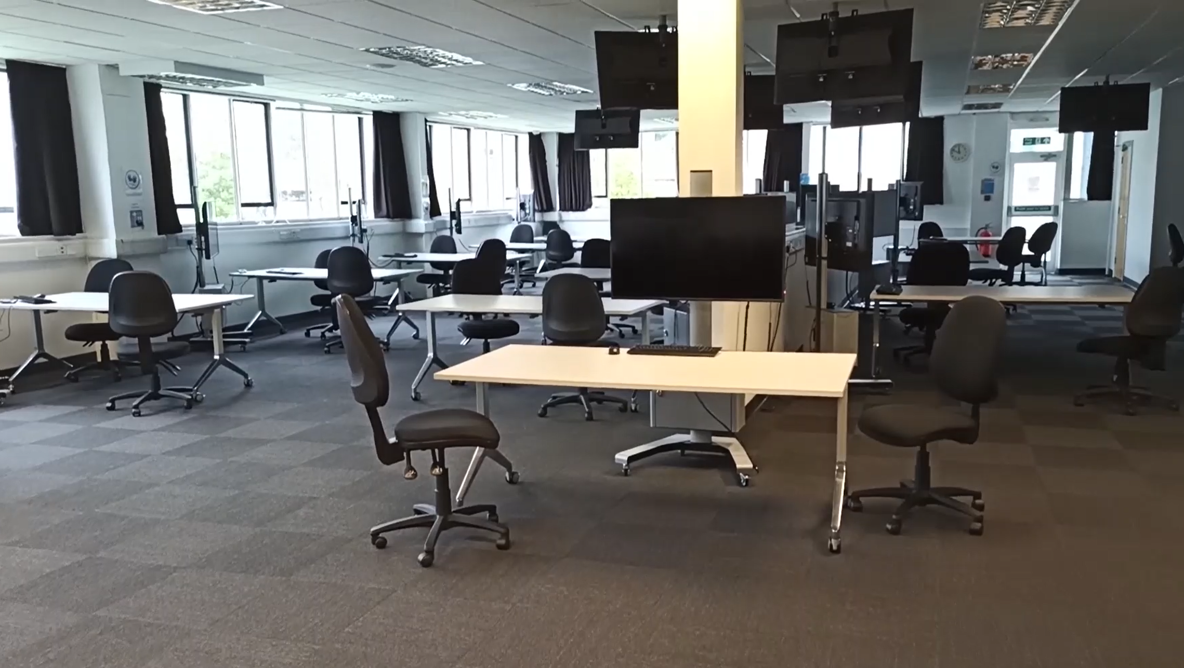
Teaching space
Large classroom designed for methods teaching
Capacity for 72 students

Slide 6
Software delivery
Students bring their own laptops/devices
PCs, Macs, Chromebooks, tablets(!)
Students can use a loan laptop (PC)
In 2020, we had two choices:
Option 1: Let students download R + RStudio
This is free, but…
Would this be easy to install?
Would it be kept up-to-date?
Would we have a multitude of device specific issues?
Would students run into package conflict issues?

Slide 7
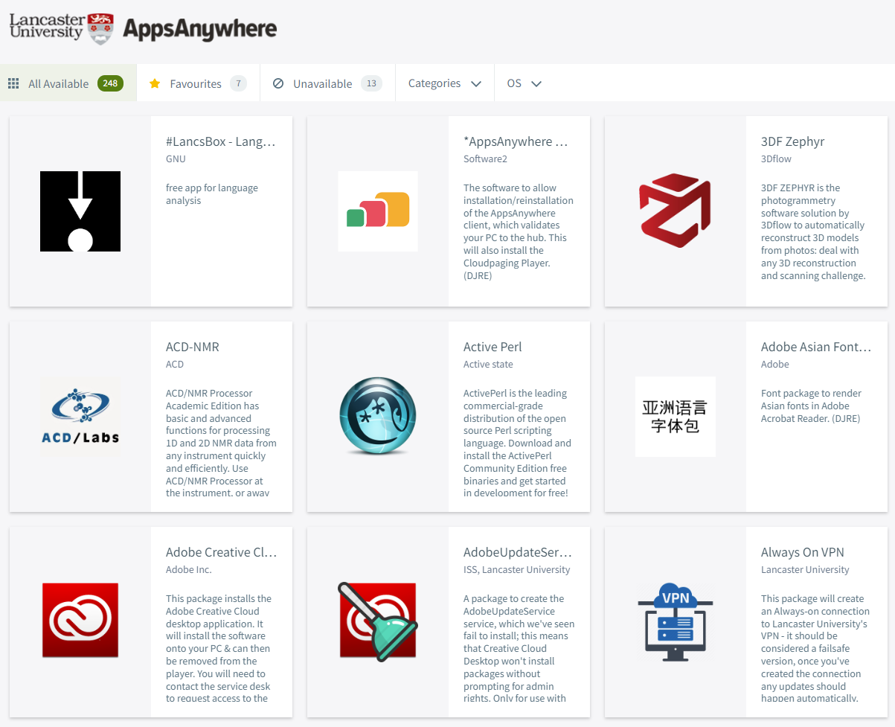
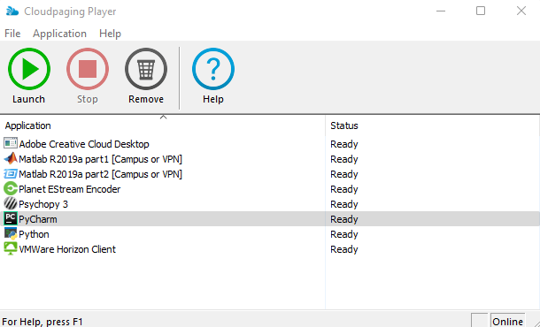
Option 2: Have students use the uni software delivery system…
This works pretty well on PC
But not at all on Macs/Chromebooks…

Slide 8
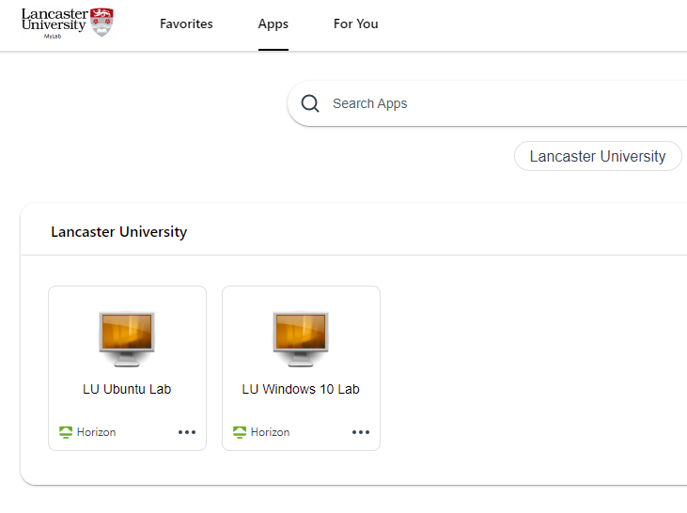

ISS: “No problem! – have them use the VDI”
The Perfect Storm
Welcome, Y1 Psych student
…in the pandemic (don’t come near me)
You’re about to do some coding
You can’t use your shiny new Mac
You need to use a “virtual desktop”
So you’ll actually be using Windows
Now “cloudpage” the RStudio software
And now download the lab data from Moodle
No, not on your device, on the VDI…

Slide 9
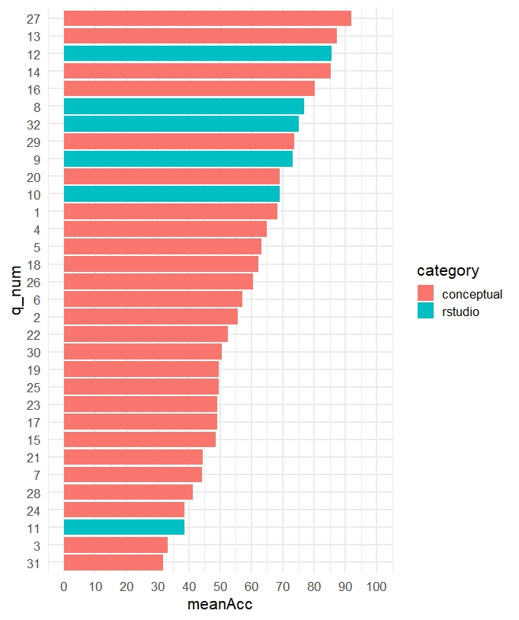



How did it go?
“I didn’t choose to do Psychology to be a hardcore programmer…”

Slide 10
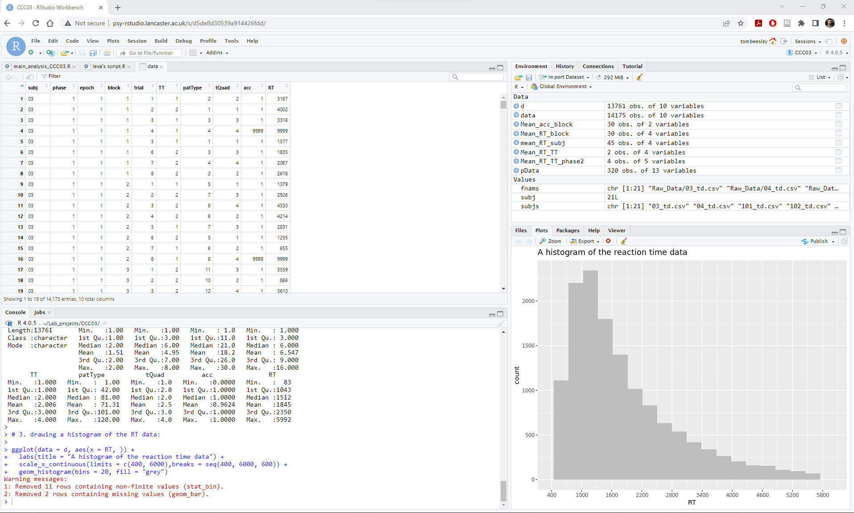
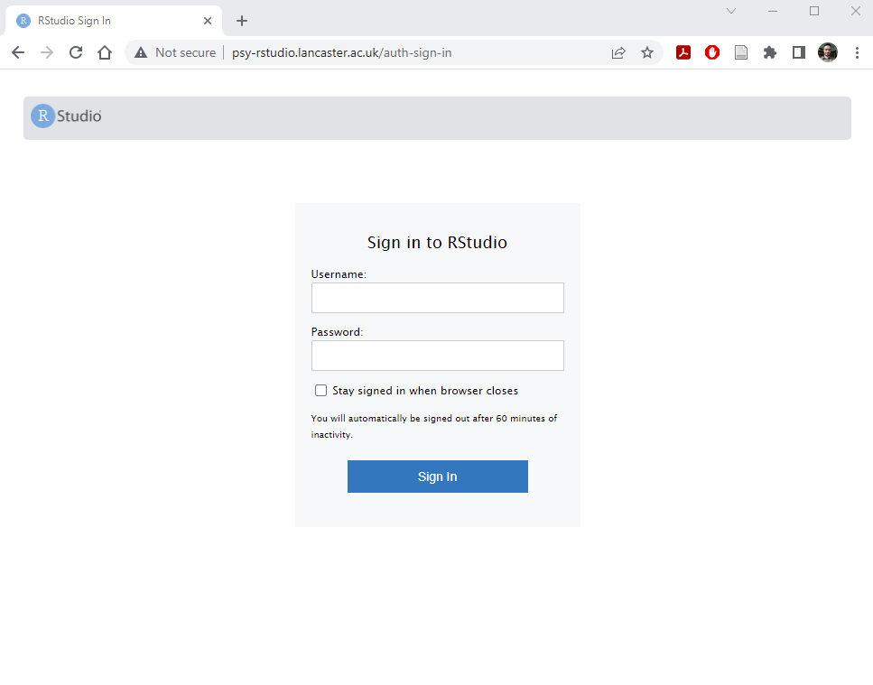
RStudio Server

Slide 11
What are the differences?
Positives
Negatives?
Updates and package installs are handled by us.
Everyone on the same version
Platform/device independent
Consistent experience across users
Project sharing
Data/scripts need to be uploaded (and work exported, if needed) – it’s not connected to local drives.
The setup and admin…

Slide 12
Setup – our experience
“Dear ISS, could you set me up with an RStudio Server?”
Their interpretation: Give him some virtual server space and let him do it…
Step 1: install the OS
Step 2: install RStudio Server
RStudio Server runs on Ubuntu (a form of Linux)
It’s VERY easy to get up and running (~1 hour)

Slide 13
Tasks involved
# jbloggs
sudo adduser jbloggs --gecos '' --disabled-password --disabled-login
echo jbloggs :C2wjg86l | sudo chpasswd
sudo usermod -a -G students jbloggs
sudo setquota -u jbloggs 50M 50M 0 0 /
# dsmith
sudo adduser dsmith --gecos '' --disabled-password --disabled-login
echo dsmith:v1wv4F3q | sudo chpasswd
sudo usermod -a -G students dsmith
sudo setquota -u dsmith 50M 50M 0 0 /
# btaylor
sudo adduser btaylor --gecos '' --disabled-password --disabled-login
echo btaylor:0yhm4Y9p | sudo chpasswd
sudo usermod -a -G students btaylor
sudo setquota -u btaylor 50M 50M 0 0 /
Adding users to the Linux server
- initially pretty simple:
sudo useradd jbloggs
…then type in the password, and then go tell jbloggs…
For 500+ users?...
Plymouth Psyc have freely available scripts.
I will do the same soon.
We are here to help!

Slide 14

Becoming a Linux nerd
Know enough to get by
(potentially know enough to be dangerous?)
Core tasks:
add/delete users
Create groups
Install/update OS/software
Monitor performance
R: install packages
I now know slightly more Linux than nothing…

Slide 15

Did it work?
Initial issues:
Some odd browser incompatibility
Ongoing maintenance?
Users “forgetting” passwords
“Stuck” sessions
Ubuntu updates
R updates
Package installs/updates
But, we can now leave it alone for weeks/months
Day 1:
It didn’t fall over!
Some teething issues…
ISS quickly upped the RAM and CPU…then all OK

Slide 16
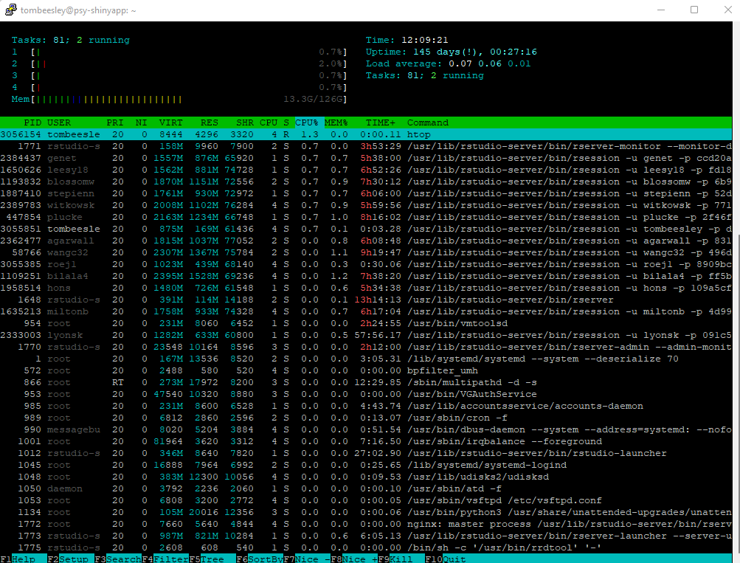
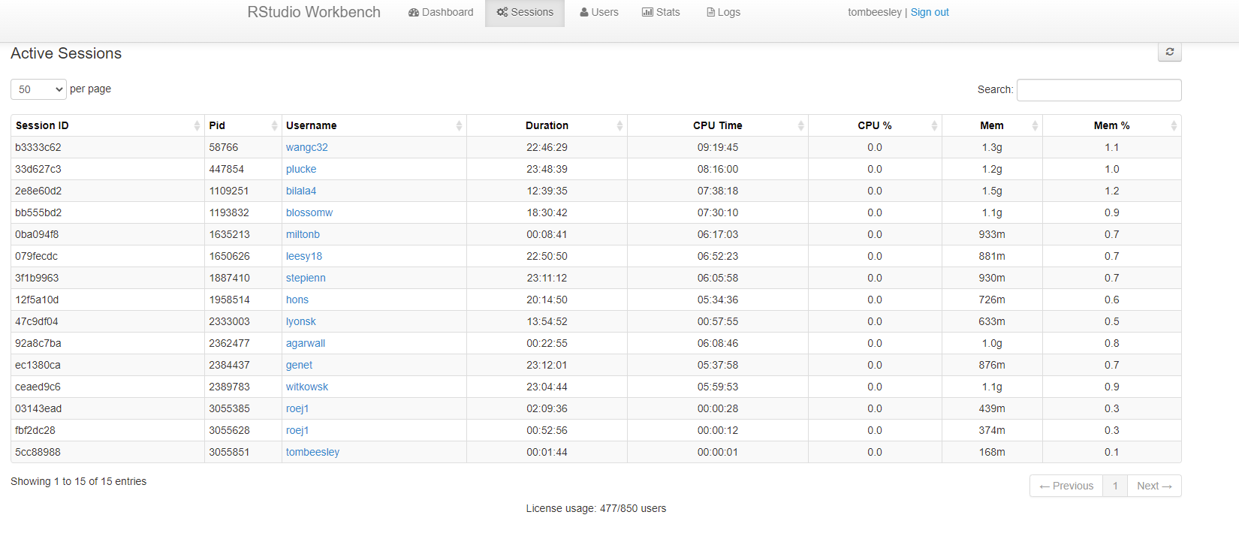
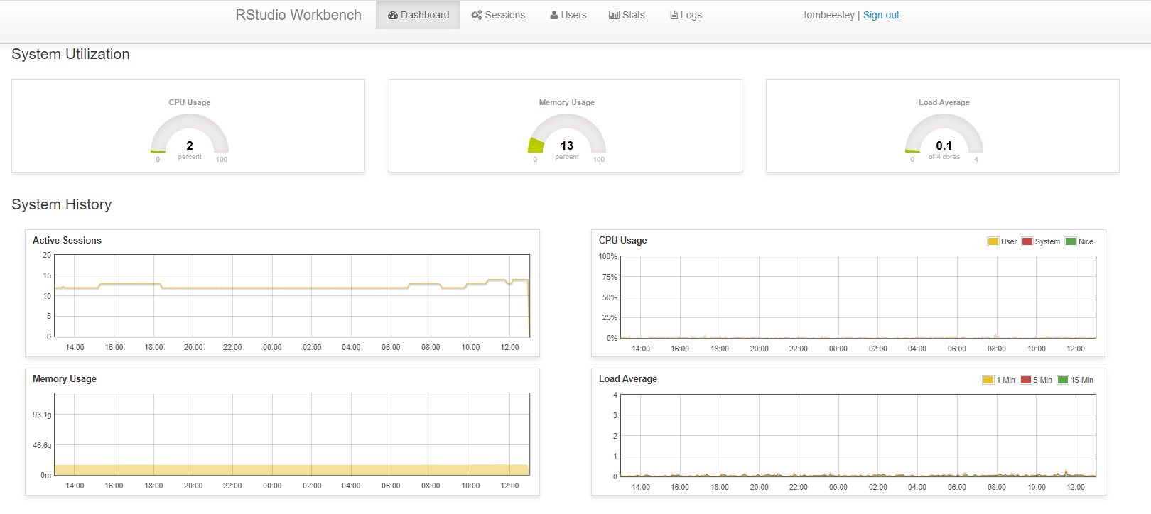
Rstudio Server Pro (workbench – free for ac.uk)

Slide 17
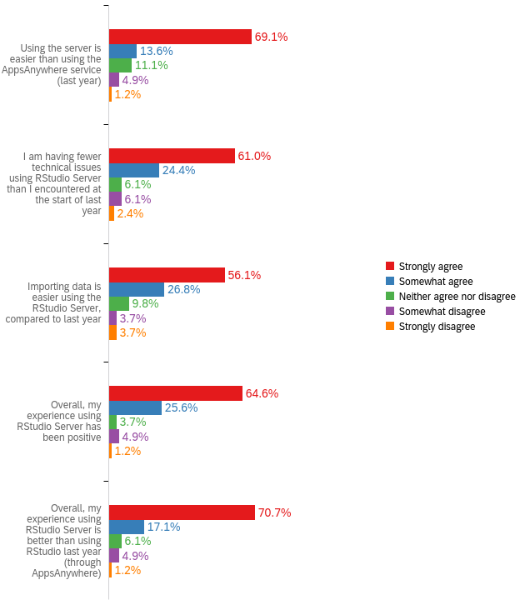
Was it worth it?
100% yes.
Student technical issues were very rare.
Student experience vastly improved
“As a Mac user, it is so much more compatible and allows me to actually complete the tasks instead of struggling with technical issues for the full hour. Thank you!”
“Last year I completed hardly any of the tasks as I couldn’t easily load the program or data files and I was so stressed. this year it seems so much more straight forward?? especially as I use a MacBook and i was having to open a windows browser etc to access it - a little bit ridiculous”

Slide 18
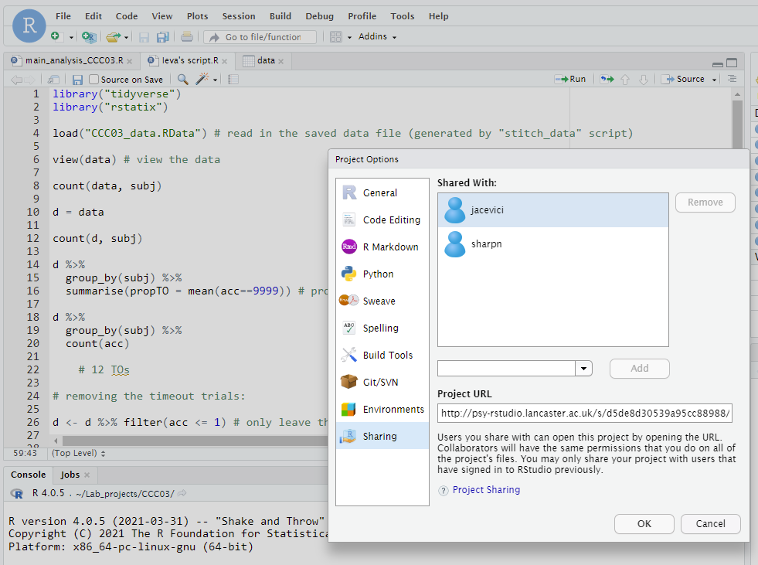
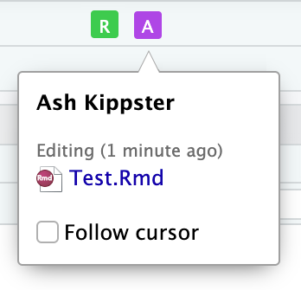
Project sharing

Slide 19
What do I recommend?
Talk to your IT services:
Assuming IT will not run this for you…
Can they allocate you some server space? (alternative – server rental?)
Can they provide any Linux support?
Are there other departments that would benefit from a R Server?
Can you use the university single sign on (SSO)?
Critical: befriend someone with Linux expertise
Start early (3 months? now?)
Ask us (Lancaster / Plymouth) for advice.

